Slide 1
The Abyssinian War & The Spanish Civil War
Jessica Ji
Period 5

Slide 2
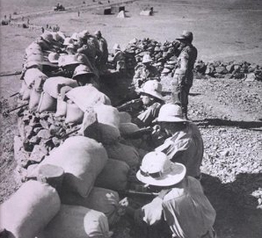
BACKGROUND of 2nd ABYSINNIAN War
The close knit internationalism of the early 1920s was crumbling, as the Soviet Union and United States became increasingly more secluded. The League of Nations was also deemed ineffective, as the great powers split paths and each acted in their own interest.
Italy had joined in the “Scramble for Africa” in the late nineteenth century but was left with worthless territories such as Eritrea and Somaliland. The Italians attempted to conquer Abyssinia (Ethiopia) but were defeated at the Battle of Adowa in 1896. The Italians pretended to sign a treaty of friendship with Haile Selassie in 1928, but Mussolini had already begun planning for another invasion of the country.
http://www.warchat.org/tag/leberation-war/

Slide 3
Rising tensions
The Italo-Ethiopian treaty of 1928 stated that the border between Italian-owned Somaliland and Ethiopia was twenty-one leagues to the Benadir coast. However, in 1930 Italy built a fort at the Wal Wal oasis and protected it with Somali troops, clearly trespassing the twenty-one league limit set by the treaty.
More about the Italo-Ethiopian Treaty here
In December 1934, the tensions erupted into a clash known as the Wal Wal Incident. According to the Italians, the Ethiopians attacked the Somalis with rifle and machine gun fire. According to the Ethiopians, the Italians attacked with two military tanks and three aircraft and that the conflict had begun as Mussolini moved troops from Somaliland and Eritrea to Abyssinia, attacking the Ethiopian peoples.
Despite the divergence in historical accounts, it is known that approximately 107 Ethiopians and 50 Italians and Somalis were killed.

Slide 4
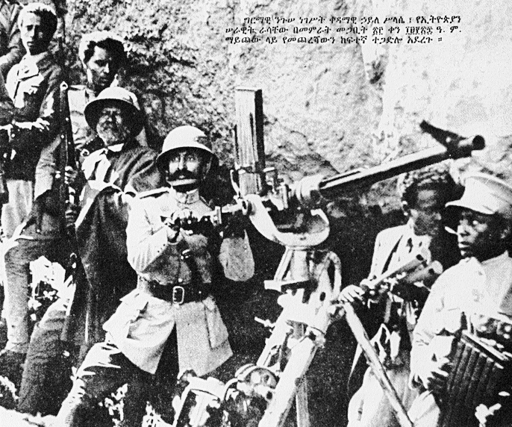
Reaction to wal wal incident
In January 1935, The League of Nations deemed both parties, Ethiopia and Italy, responsible for the incident but absolved both parties from any charge.
Following the incident, French Minister Pierre Laval met with Mussolini the same month to discuss a Franco-Italian Agreement. This treaty gave Italy parts of French Somaliland and essentially gave French consent for Italy to deal with Ethiopia. In exchange, France wanted Italian support against German offensives.
http://www.angelfire.com/ny/ethiocrown/images/maichew.gif
Read more concerning the Wal Wal Incident

Slide 5
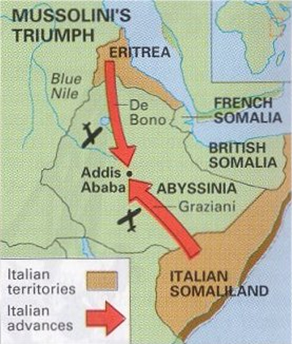
A map of the Italo-Ethiopian Abyssinian War from October 3rd, 1935 – March 31, 1936
Notice General De Bono’s advance into Abyssinia
http://www.warchat.org/pictures/second_italo-abyssinian_war_1935-1936_war_map.jpg
Click for a complete timeline of the Second Abyssinian War

Slide 6
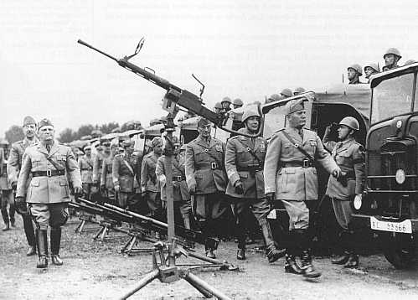
Mobilization & Invasion
On February 10, 1935 Mussolini mobilized two divisions of the Italian army and began sending the men to Italian possessions in Eritrea and Somaliland. As the Italians continued to accumulate at the border of Ethiopia, the African country requested arbitration from the League of nations and protested the Italian mobilization on May 11, 1935. On September 25, Ethiopia began to mobilize its large but ill-equipped army.
On October 3, 1935 Italian forces
stationed in Eritrea invaded Ethiopia
and forced Ethiopia to declare war
on Italy.
Back to map
http://comandosupremo.com/wp-content/uploads/2011/06/01.jpg

Slide 7
Factors IN THE WAR
The League of Nations began to impose sanctions upon Italy in October 1935, but sanctions on crucial Italian materials such as oil were not fulfilled by all members of the League. Because both Britain and France overestimated the size of the Italian Navy, Great Britain kept the Suez Canal open; if the route had been cut, Italy would not have been able to bring supplies to her forces.
In an attempt to end the war, Samuel Hoare of Britain and Pierre Laval of France met in December 1935 and created the Hoare-Laval Plan. This would have ended the war, giving Italy large areas of Ethiopia. However, the plan was leaked to the press and stirred an uprising in Britain and France, causing both to drop the plan. This however, created an illusion that both nations were not serious about the principalities of the league.
At the close of 1935, The League had shown nations that its sanctions were in effect, useless even when enforced. It became known that member states were even negotiating with aggressor states to avoid involvement of the League.
More about the League during the War
Back to map

Slide 8
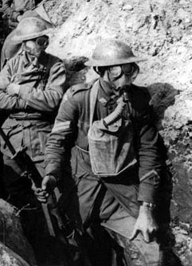
FINAL ADVANCES IN WAR
In December 1935, with the war effort moving slowly, General Badoglio was given permission to use chemical warfare agents such as mustard gas against the enemy. The gas, delivered by bombers of the Italian Air Force, surprised the Ethiopians who had no prior knowledge of the poison gas.
On April 26, 1936 Badoglio ignited his “March of the Iron Will” from Dessie to Addis Ababa. Haile Selassie of Ethiopia moved his government to Gore and fled the capital. While the Ethiopians did not formally surrender, on May 5, 1936, the Second Abyssinian War was over. Ethiopia merged with the Italian possessions of Eritrea and Somaliland, creating a new state of Italian East Africa.
http://2.bp.blogspot.com/-4w-REo76Y9g/TaH7TKZyS7I/AAAAAAAAPQs/sNEYWfjZonM/s1600/poison_gas_400px.jpg
Back to map
Read about the “March of the Iron Will”

Slide 9
Effects of the WAR
The League of Nations lost its credibility, after its sanctions on the Italians were deemed useless. The sanctions were not placed on the most vital resources that affected the war and barely hampered the military advancement of the Italian forces.
Britain and France surpassed the league’s authority to the point as to fashion a treaty with the aggressor nation despite the neutrality enforced by the League. When the Hoare-Laval plan was exposed, the foundation of the League was severely weakened and lost much of its power.
Back to map

Slide 10
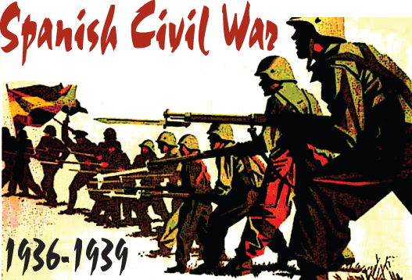
BEGINNINGS OF THE SPANISH CIVIL WAR
http://trcs.wikispaces.com/file/view/SpanishCivilWar-1%28RBM%29.jpg/74017839/486x330/SpanishCivilWar-1%28RBM%29.jpg
All of Europe became increasingly divided between the Marxist Left and the Fascist Right. Proving the very depth of this divide was the Spanish Civil War, fought between the Republicans, loyal to the Spanish republic, and the Nationalists, a rebellious group led by General Francisco Franco.

Slide 11
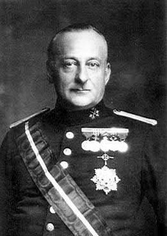
Background of the Civil WAr
In 1923, General Miguel Primo de Rivera assumed office as the dictator of Spain and instilled various Mussolini-like policies. However, popular discontent and economic failure forced Primo de Rivera out of office and into exile in 1930.
In elections held the following year, republicans ushered in a Second Spanish Republic. However, political turmoil struck Spain, as the government capriciously shifted between liberal leftist and conservative governments.
The War had been an outcome of the complete fractionalization of Spain into parties. On one side was the Roman Catholic Church, businessmen, and landowners. On the other were rural laborers, city workers, and the educated middle class. The eruption of civil war was inevitable.
Primo de Rivera
http://upload.wikimedia.org/wikipedia/en/c/cf/Primo-de-rivera.JPG
Read about Primo de Rivera

Slide 12
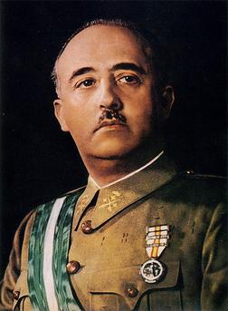
Uprising of the nationalists
An uprising of the Nationalists, led by General Francisco Franco, began on July 17, 1936 by Spanish army officers stationed in Morocco. As they gained control throughout Spanish territory, more and more people fell victim to political assassination.
The Nationalist government was headed by Franco and set up in Burgos. The republican government was headed by Socialist figure Francisco Caballero. Realizing the importance of a modern mass appeal and disciplined development, Franco and his Nationalists appealed to all monarchists and fascistic Falangists (Falange was a movement modeled after Fascism), and to all clergy and those who against communism.
Francisco Franco
http://1.bp.blogspot.com/-4KIfemCmmbc/Ti5Peio28ZI/AAAAAAAAFBM/5FRv059Ywog/s1600/25587573.jpg

Slide 13
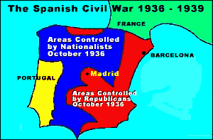
Political Parties of the Spanish Civil WAR
The factional divisions of the Spanish Government into Nationalist and Republican. These divisions show the almost equal areas of National and Republican influence in Spain.
http://www.english.illinois.edu/maps/scw/photoessay/map1.gif

Slide 14
Foreign support
Because neither side believed themselves strong enough to win the war on their own, both called on nations abroad for help. Nationalists received help from Fascist Italy and Nazi Germany who sent troops, tanks, and planes to Franco. Germany and Italy formed the Rome-Berlin Axis, while Japan and Germany established mutual neutrality and opposition to communism in their Anti-Comintern Pact. Mussolini joined the war to bolster Italy’s prestige while Hitler used the civil war as an opportunity to test German weaponry.
The republicans, also known as the Loyalists, received equipment and supplies from the Russian Soviets, as well as France and Mexico. They viewed their party as defenders of democracy against fascism.
Learn more about the Political Divisions of the War
Back to map

Slide 15
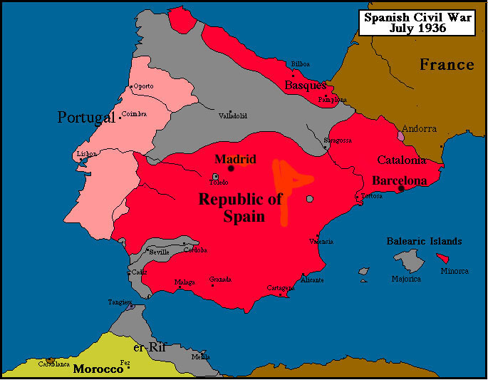
Conflict
By November 1936, the Nationalists had pushed to the very borders of Madrid. During the summer of 1937, they captured the Basque northern provinces and by October that same year, extended their influence to the entire northern coast of Spain. In April 1938, they drove eastward through Teruel to the Mediterranean Sea, splitting the republic in two.
In December 1938, they moved into Catalonia in the northeast, forcing the Republican armies, along with a large number of civilians to intrude into French territory.
On March 5th, 1939, the Republican government officially fled to France and by March 28th, all Republican forces surrendered, allowing Nationalist Forces to enter Madrid.
“Map of Spain 1936”
For reference to various cities
https://www2.bc.edu/~heineman/maps/SpCW1.jpg
Click for a complete Timeline of the Civil War
Back to map

Slide 16
Importance of the war
The Nationalist capture of Catalonia sealed the republic's defeat. Thus, Republican efforts to negotiate peace in early 1939 failed.
Great Britain and France acknowledged the Franco regime in February and international recognition quickly followed. Yet, the war is thought to have cost 500,000 lives and have a casualty figure as high as 1 million.
The war witnessed the first ever deliberate aerial bombing of a city. On April 27th 1937, the city of the Basques (Guernica) was bombed and destroyed by Germany.
The effects: It was a useful, practical experiment for the impacts of bombing civilian targets for Hitler. However, for the Nationalists it destroyed a city of much spiritual importance. For Europe, the warning posed by this bombing foreshadowed the horrible nuclear warfare to come. Thus, the consequences of the Civil War were great and ominous, signaling the dangers yet to come for Europe.
Back to map

Slide 17
Abyssinian War- CHECKPOINT
How was the League of Nations’ involvement and influence in the Second Italo-Abyssinian War limited, and why did the sanctions have a limited effect on Italy?
    Not sure?
What impact did the Franco-Italian Agreement have on the War?
        Not sure?
How did Britain forever alter the course of the war for Italy?
        Not sure?
Why did the Hoare-Laval plan ultimately not succeed?
        Not sure?

Slide 18
Spanish Civil War- CHECKPOINT
What government took control after the abdication of General Miguel Primo de Rivera?
    Not sure?
To what parties did the Nationalist movement appeal? How did these differ from those of the Republican government?
    Not sure?
How did the involvement of other European nations affect either side of the War?
    Not sure?
What advancement caused the Republicans to be split in half, resulting in the end of the war?
    Not sure?

Slide 19
Thank you for reading

Slide 20
Works CITED
"Abyssinia 1935." Abyssinia 1935. N.p., n.d. Web. 04 Mar. 2013.
"Abyssinia Crisis." Wikipedia. Wikimedia Foundation, 27 Feb. 2013. Web. 04 Mar. 2013.
Chambers, Mortimer. The Western Experience. 9th ed. N.p.: n.p., n.d. Print.
"Second Italo-Ethiopian War." Wikipedia. Wikimedia Foundation, 03 May 2013. Web. 04 Mar. 2013.
"Spanish Civil War." The Papers Project. N.p., n.d. Web. 4 Mar. 2013.
"Spanish Civil War." Spanish Civil War. N.p., n.d. Web. 04 Mar. 2013. "Spanish Civil War." Wikipedia. Wikimedia Foundation, 03 May 2013. Web. 04 Mar. 2013.
"The Spanish Civil War." The Spanish Civil War. N.p., n.d. Web. 04 Mar. 2013.
"The Spanish Civil War: An Overview--by Cary Nelson." The Spanish Civil War: An Overview--by Cary Nelson. N.p., n.d. Web. 04 Mar. 2013.

